Slide 1
Session 5
JSP Application Models

Slide 2
Session Objectives
Describe different JSP-based application models
  Model I
  Model II
Describe the J2EE framework
Explain the use of the RequestDispatcher Interface
Explain Exception Handling in JSP

Slide 3
Introduction
An Application model can be used to develop an application in the most effective way.
There are primarily two different models –
  Model I
  Model II.
The J2EE framework is also used to simplify complexities associated with development, deployment and management of multi-tier enterprise solutions.
There are different Application models with their own merits and demerits.

Slide 4
Various JSP-based application models
Multiple roles and responsibilities exist in an application development project.
A Web production role –
  An individual who designs the HTML pages.
A Software developer –
  An individual who creates the software in the Java programming language.
In small-scale projects the roles may intermingle.
For large-scale projects the main problem is complexity of the application design.

Slide 5
Some of the key issues
How to separate out the presentation logic from the actual code?
Where should the presentation logic be placed?
  For a large project, the presentation logic itself may consist of a large amount of the fixed template data and the dynamic content.
  Then the next problem is how to separate the dynamic content from the fixed template data.
Where should the actual code, that is, the application logic reside?

Slide 6
Some of the key issues – (1)
A Large-scale Project
Presentation
Logic
Application Logic
Static
Template
Data
Dynamic
Content

Slide 7
Some important points
Redirecting and Forwarding requests from clients
  A servlet or a JSP resource may choose to redirect the client (using response.redirect(URL)).
  The request object does not reach the second resource directly; since, the underlying implementation is an HTTP redirect.
  The lifecycle of the initial request object that was accessed in the first JSP terminates with the end of the service method in the first JSP, or with the reply from the server.

Slide 8
Some important points – (1)
In a forward mechanism, the request object is forwarded to the second resource.
Any object binding to the request and its state is easily maintained, without having to make a round trip to the client on the network.
This allows the first JSP to partly process the client request and then forward it to the second JSP to finish processing the remaining part of the client request.

Slide 9
Various application models
The first method
  is known as the page-centric approach.
  involves request invocations being made directly to JSP.
  also known as Model I.

Slide 10
Various application models – (1)
The second method uses the dispatcher or N-tier approach.
  Involves a basic servlet or a JSP
  acts as mediator or controller
  delegates requests to JSPs and JavaBeans.
  Known as Model II.

Slide 11
The JSP Model I Architecture
JSP is responsible for
  processing the incoming client request
  replying back to the client
Application logic enclosed in JavaBeans
Presentation logic enclosed in JSPs
Suitable for small applications not so for large applications

Slide 12
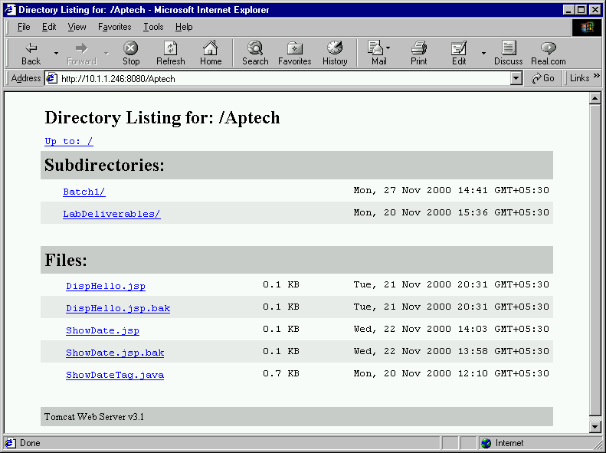
The JSP Model I Architecture – (1)
JSP
Request
Response
JavaBean/ EJB
Data Source
Browser
Application Server

Slide 13
An Example
The Bean – TimeBean.java
package beans;
import java.util.*;
public class TimeBean {
private int hours;
private int minutes;
private int seconds;
public TimeBean() {
hours = 0; minutes = 0; seconds = 0; }

Slide 14
An Example – (1)
public int getHours() {
return hours; }
public int getMinutes() {
return minutes; }
public int getSeconds() {
return seconds; }
public void setHours(int hrs) {
hours = hrs; }
public void setMinutes(int mins) {
minutes = mins; }
public void setSeconds(int sec) {
seconds = sec; }
}

Slide 15
An Example – (2)
The JSP – displayTime.jsp
<HTML> . . .
<%@ page language = "java"
import = "beans.TimeBean, java.util.*" %>
<jsp:useBean id = "id_TimeBean"
class = "beans.TimeBean" />
<%
TimeZone timeZone = TimeZone.getDefault();
Calendar myCalendar = Calendar.getInstance(timeZone);
id_TimeBean.setHours(myCalendar.get(Calendar.HOUR_OF_DAY));
id_TimeBean.setMinutes(myCalendar.get(Calendar.MINUTE));
id_TimeBean.setSeconds(myCalendar.get(Calendar.SECOND));
%>

Slide 16
An Example – (3)
<%
if (id_TimeBean != null) {
out.print("<P> <B> The time now is: </B>");
out.print(id_TimeBean.getHours());
out.print(":");
out.print(id_TimeBean.getMinutes());
out.print(":");
out.print(id_TimeBean.getSeconds());
} else {
out.print("Select a TimeZone first");
} %>
. . .</HTML>

Slide 17
The JSP Model II Architecture
Hybrid approach
  Uses both Servlets and JSPs for serving the dynamic content
  JSP – used for the presentation layer
  Servlets perform the process-intensive tasks
Servlet acts as a controller
  Responsible for creating beans and objects required by the JSP
JSP does not contain any processing logic
  Responsible for retrieving any bean or object created by the servlet

Slide 18
The JSP Model II Architecture – (1)
Controller
Servlet/JSP
Request
Instantiate
Response
JSP
JavaBean
/EJB
Data Source
View
Browser
Model
Application Server

Slide 19
The JSP Model II Architecture – (2)
The two different categories
Front end JSPs or Servlets
  Manage the application flow and business logic evaluation
  Responsible for intercepting the HTTP requests coming from the client
Presentation JSPs
  Generates the HTML or XML
  Presents the dynamic content

Slide 20
An Example
The Model View Architecture
Model: The bean – TimeBean.java
setHours()
setMinutes()
setSeconds()
Processes current time in
hours
minutes
seconds
getHours()
getMinutes()
getSeconds()

Slide 21
An Example – (1)
Controller: first.jsp
<HTML> . . .
<%@ page language = "java"
import = "beans.TimeBean, java.util.*" %>
<jsp:useBean id = "id_TimeBean"
scope = "session" class = "beans.TimeBean" />
<%
TimeZone timeZone = TimeZone.getDefault();
Calendar myCalendar = Calendar.getInstance(timeZone);

Slide 22
An Example – (2)
id_TimeBean.setHours(myCalendar.get(Calendar.HOUR_OF_DAY));
id_TimeBean.setMinutes(myCalendar.get(Calendar.MINUTE));
id_TimeBean.setSeconds(myCalendar.get(Calendar.SECOND));
%>
<jsp:forward page = "displayTime2.jsp" />
. . .
</HTML>

Slide 23
An Example – (3)
View: displayTime2.jsp
<HTML>. . .
<jsp:useBean id = "id_TimeBean"
scope = "session" class = "beans.TimeBean" />
<P> <B> Current time is: </B>
<jsp:getProperty name = "id_TimeBean"
property = "hours" />:
<jsp:getProperty name = "id_TimeBean"
property = "minutes" />:
<jsp:getProperty name = "id_TimeBean"
property = "seconds" />
. . .</HTML>

Slide 24
The JSP Model II Architecture – (3)
The variables are wrapped and placed in the Session Object.
This has two weaknesses –
  The Session may not be available because the client has refused to participate.
  The Session variable continues to exist unless it is explicitly removed, destroyed or it expires.

Slide 25
The JSP Model II Architecture – (4)
First case is likely to happen when –
  Cookies are used for tracking sessions instead of URL rewriting.
The second case is even more serious –
  When objects get instantiated with the session scope, they are not removed until the session ends. The garbage collector is unable to collect these objects.
  As the session progresses, the memory usage increases and persists until the client ends the Session or the session times out.

Slide 26
A Better Option
Beans can be placed into the Request object
  RequestDispatcher.include() is to be used instead of RequestDispatcher.forward().
View page will have access to the same Request object of the Controller.

Slide 27
The J2EE Framework
In today’s world of complex enterprise systems, corporations are trying to purchase solutions that will offer them
  faster time-to-market
  lower the developmental costs.
These solutions are based on two major technologies:
  J2EE
  Windows DNA

Slide 28
The J2EE Framework – (1)
J2EE
Windows DNA
Java 2 platform Enterprise Edition based products from Sun Microsystems.
Includes server-side components framework.
Windows Distributed InterNet Application Architecture from Microsoft.
Contains the COM+ server-side component architecture

Slide 29
The J2EE Framework – (2)
J2EE was designed to simplify the complicated problems associated with
  Development
  Deployment,
  Management of the multi-tier enterprise solutions.
An open-industry standard
  Is the result of the concerted efforts of a group of large industries led by Sun Microsystems.
Cornerstone of the J2EE is Enterprise JavaBeans.

Slide 30
The J2EE Framework – (3)
EJB is the standard for building server-side components in Java.
J2EE also supports cross-platform development, since it rests on the platform-independent JVM.
Platforms include
  Solaris
  Linux
  IBM OS/390
  Microsoft Windows

Slide 31
Java Platform for the Enterprise
Sun Microsystems announced an initiative called Java Platform for the Enterprise – JPE.
JPE consisted of Enterprise Java APIs, which included –
  Enterprise JavaBeans
  Servlets
  Java Naming and Directory Interface technologies.

Slide 32
Java Platform for the Enterprise – (1)
The goal of JPE was to allow any middleware vendors implement a standardized execution environment for distributed enterprise applications, either on top of their existing, proven middleware solutions or as part of the new emerging products.
An application developer using Enterprise Java APIs will gain a platform-neutral and vendor-neutral interface for server-side programming.

Slide 33
J2EE
The JPE initiative evolved into the J2EE.
J2EE consists of the following deliverables:
  The J2EE Platform Specifications
  The J2EE Reference Implementation
  The J2EE Compatibility Test Suite
  The J2EE Blueprints

Slide 34
The Various Components of the J2EE Framework
Component
Description
Enterprise Java Beans (EJB)
Architecture for building re-usable server-side components. Defines rules governing EJB containers and the components that reside within these.
Java Database Connectivity (JDBC)
Java technology-based relational database interface. Allows access to any relational resource that has a corresponding driver, such as Oracle, Informix, and SQL Server.
Java Naming and Directory Interface (JNDI)
Used to locate resources over the network, such as EJB components, database drivers, and security credentials.

Slide 35
The Various Components of the J2EE Framework – (1)
Java Remote Method Invocation over the Internet Inter-ORB Protocol (RMI-IIOP)
The RMI-IIOP Interface enables method invocations across JVMs. If an IIOP protocol is used, J2EE can integrate with non-Java code written to the CORBA standard, such as C++ or COBOL code.
Java Message Service (JMS)
Enables asynchronous communications, including point-to-point and publish/ subscribe messaging.
Java Interface Definition Language (Java IDL)
Adds CORBA technology to the Java platform. Provides standards based interoperability and connectivity.

Slide 36
The Various Components of the J2EE Framework – (2)
Connectors
Provides access to existing enterprise information systems, such as CICS, Tuxedo, SAP R/3, and PeopleSoft.
JavaServer Pages (JSP)
Technology that allows Web pages to be dynamically generated. Enables Web designers without serious programming knowledge to leverage the middleware.
Java Servlets
Similar to the JSP technology, servlets are request/ response oriented components that are typically deployed in a Web server. These are used to manage the session state and generate HTML dynamically.

Slide 37
The Various Components of the J2EE Framework – (3)
Java Transaction API (JTA)
Used to demarcate transactional boundaries programmatically.
eXtensible Markup Language (XML)
The Java XML API provides an interface to an XML parser and a set of commonly used methods for manipulating XML.
JavaMail
Used to send electronic mail, such as an order confirmation.
JavaBeans Activation Framework (JAF)
Enables the automatic activation of classes needed to manipulate various types of media (needed for mails sent via Java Mail).

Slide 38
The Various Components of the J2EE Framework – (4)
Java 2 Platform, Standard Edition (J2SE)
Formerly known as Java 2. Is the underlying Java platform that rests beneath J2EE.
Load balancing, data caching, transparent fail-over, and other services
These services, do not require a specification. A middleware vendor provides these services without affecting application code. J2EE was designed to allow vendors differentiate themselves in these areas by offering varying qualities of service.

Slide 39
The J2EE Object Model
Presentation Tier
Web Server
Business Tier
Application Server
Data Tier
Database

Slide 40
The J2EE Object Model – (1)
HTML Client
CORBA
Client
Java Applet
Java Application
HTTP
Servlet
JSP
RMI - IIOP
Web Server
CORBA/ IIOP
RMI - IIOP
HTML/DHTML/XML
RMI - IIOP
Presentation Tier

Slide 41
The J2EE Object Model – (2)
CORBA Delegation
EJB Session Bean
Libraries written in C++, Java, COBOL, etc.
Application Server
EJB Entity Bean
Connector
Business Tier
JDBC/ SQLJ
Proprietory Protocol
Database
Existing System
Legacy System
ERP System
Data Tier

Slide 42
The J2EE Object Model – (1)
Presentation Tier
  Contains components dealing with user interfaces and user interaction, such as rich graphical user interface code or the HTML code.
  Can include CORBA clients, Java applets, Java applications, Java servlets, JavaServer Pages (JSP) and other static Web pages.
Business Tier
  Contains the business rules and data processing logic.
  EJBs are used to encapsulate this logic.

Slide 43
The J2EE Object Model – (2)
Data Tier
  Contains databases, existing enterprise systems, legacy systems or an ERP system, such as SAP or PeopleSoft.
  JDBC can be used to connect to this tier.
  SQL/J is another option, which can be used to interface Java code with SQL.

Slide 44
The RequestDispatcher Interface
The Model II architecture depends on a request being dispatched to another resource. This request dispatching is carried out by the implementation of the RequestDispatcher interface. This interface defines an object that can serve as a wrapper around another resource on the server.
The Servlet 2.1 specification introduced this interface. It can dispatch a request to a static request, such as an HTML page, or another dynamic resource, such as a Servlet or JSP.

Slide 45
The RequestDispatcher Interface – (1)
It has two important methods:
include()
A servlet that invokes RequestDispatcher.include() retains the overall responsibility for the service request, handling the response to the client.
forward()
This method is used to forward a request from one servlet to another. It allows the controller servlet or JSP to perform some initial tasks on the request before forwarding it to another.

Slide 46
An Example
Controller: Controller.jsp
<HTML> . . .
<%@ page language = "java"
import = "beans.TimeBean, java.util.*" %>
<jsp:useBean id = "id_TimeBean"
scope = "request" class = "beans.TimeBean" />
<%
TimeZone timeZone = TimeZone.getDefault();
Calendar myCalendar = Calendar.getInstance(timeZone);
id_TimeBean.setHours(myCalendar.get(Calendar.HOUR_OF_DAY));
id_TimeBean.setMinutes(myCalendar.get(Calendar.MINUTE));
id_TimeBean.setSeconds(myCalendar.get(Calendar.SECOND));
%>
. . .</HTML>

Slide 47
An Example – (1)
View: DisplayTime3.jsp
<HTML>. . .
<jsp:include page = "Controller.jsp" flush = "true" />
<jsp:useBean class = "beans.TimeBean"
id = "id_TimeBean" scope = "request" />
<P> <B> The Current Time is: </B>
<jsp:getProperty name = "id_TimeBean"
property = "hours" />:
<jsp:getProperty name = "id_TimeBean"
property = "minutes" />:
<jsp:getProperty name = "id_TimeBean"
property = "seconds" />
. . . </HTML

Slide 48
Handling JSP Errors
The role of exception object
Two different errors may occur during the lifecycle of a JSP
  Translation time errors
  Request time errors

Slide 49
JSP Translation time errors
This type of errors occur when a JavaServer Page is first requested and goes through the initial translation from a JSP source file to a servlet class file. These errors are usually the result of compilation failures and are known as translation time errors.
<HTML> . . .
<% out.println("<H1>Hello JSP World!!</H1>")
. . .</HTML>
?

Slide 50
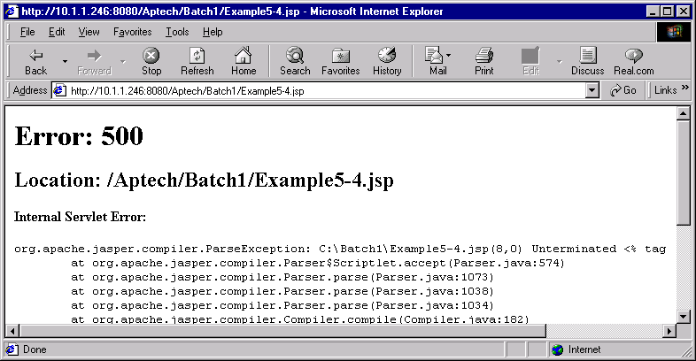
JSP Translation time errors – (1)

Slide 51
JSP Request time errors
This type of errors occurs during the request time. These are actually runtime errors, which can occur in either the body of the JSP or in some other object that is called from the body of the JSP.
1/0 = ?
divide-by-zero

Slide 52
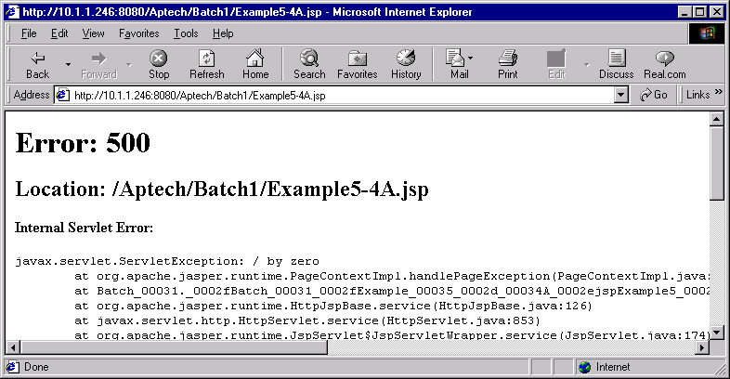
JSP Request time errors – (1)

Slide 53
Creating a JSP error page
<%@ page isErrorPage = "true" import = "java.io.*" %>
<HTML>. . .
<CENTER> <H1> The JSP Error Page
</H1> <TABLE BORDER = "1" >
<TR>
<TD> Exception </TD>
<TD><%= exception %> </TD>
</TR>
<TR>
<TD>Message</TD>
<TD> <%= exception.getMessage() %></TD>
</TR>
</TABLE>
</CENTER>
. . . </HTML>
Directive required for error pages

Slide 54
Using a JSP error page
Directive required for error pages
<HTML> . . .
<!-- Include the error page -->
<%@ page errorPage = "MyErrorPage.jsp" %>
<%= 1/0 %>
. . .</HTML>
Raise the exception

Slide 55
The JSP specific error classes
Throwable
Error
Exception
JspException
JspError

